Slide 1
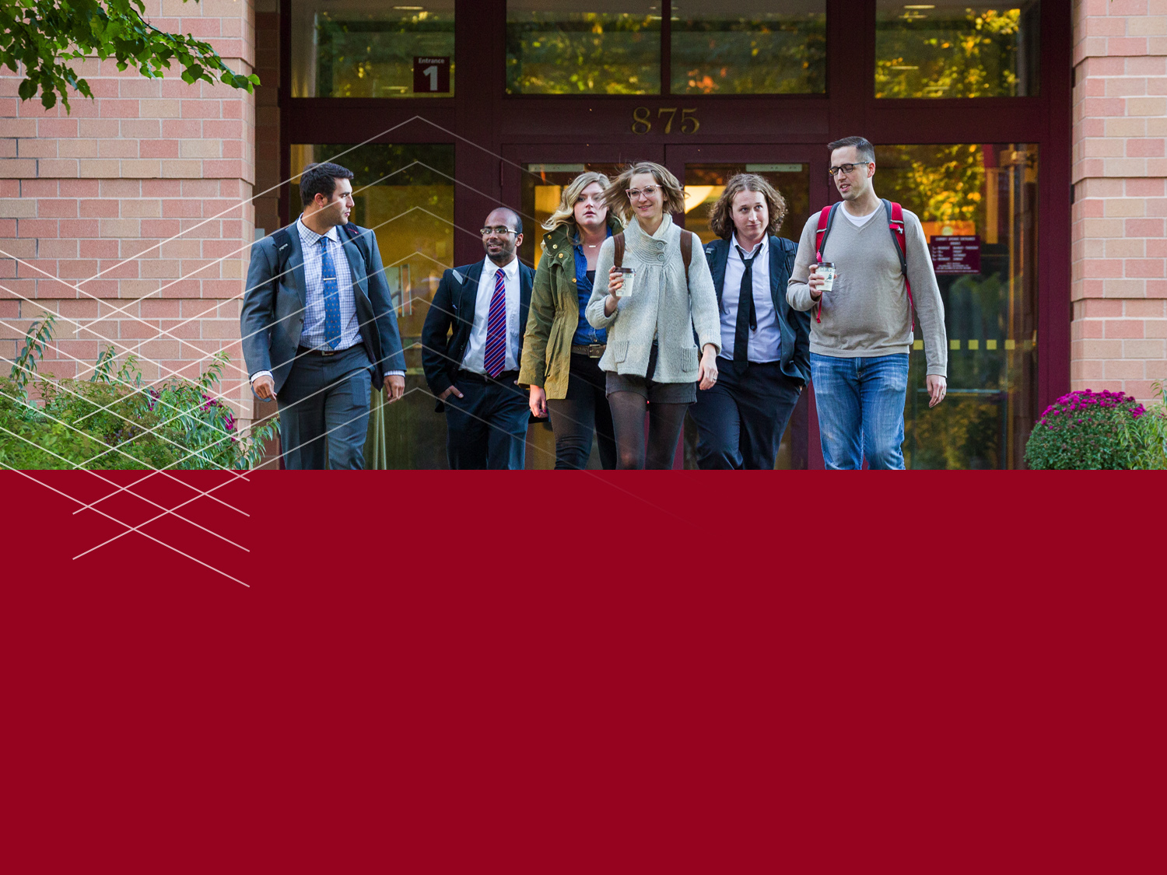
This would be a brief description
December 15, 2015

Slide 2

PREHEADER HERE:
Chapter title to go here.
This would be a brief description of what we will go through in this chapter. More copy goes here.
December 15, 2015
Mitchell Hamline School of Law | 2

Slide 3

PREHEADER HERE:
Chapter title to go here.
This would be a brief description of what we will go through in this chapter. More copy goes here.
December 15, 2015
Mitchell Hamline School of Law | 2

Slide 4
Slide title to go here.
THIS IS A SUBHEAD
Et modi am il magnimint restiuris volorum nonsedi ilicill uptatem et, ni beroreste pratur aditaqu.
THIS IS ANOTHER SUBHEAD
Et modi am il magnimint restiuris volorum nonsedi ilicill uptatem.
THIS IS ALSO A SUBHEAD
Et modi am il magnimint restiuris volorum nonsedi ilicill uptatem et, ni beroreste pratur aditaqu.
December 15, 2015
Mitchell Hamline School of Law | 2

Slide 5
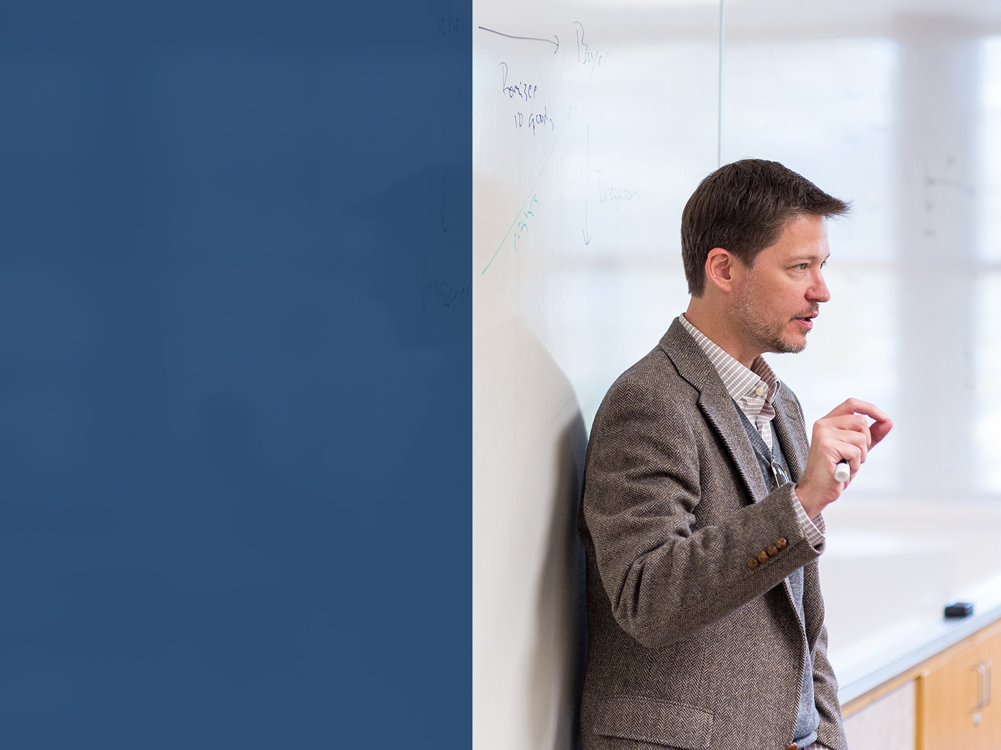
“Quote, copy content, or other information may be located here.”
December 15, 2015
Mitchell Hamline School of Law | 2

Slide 6
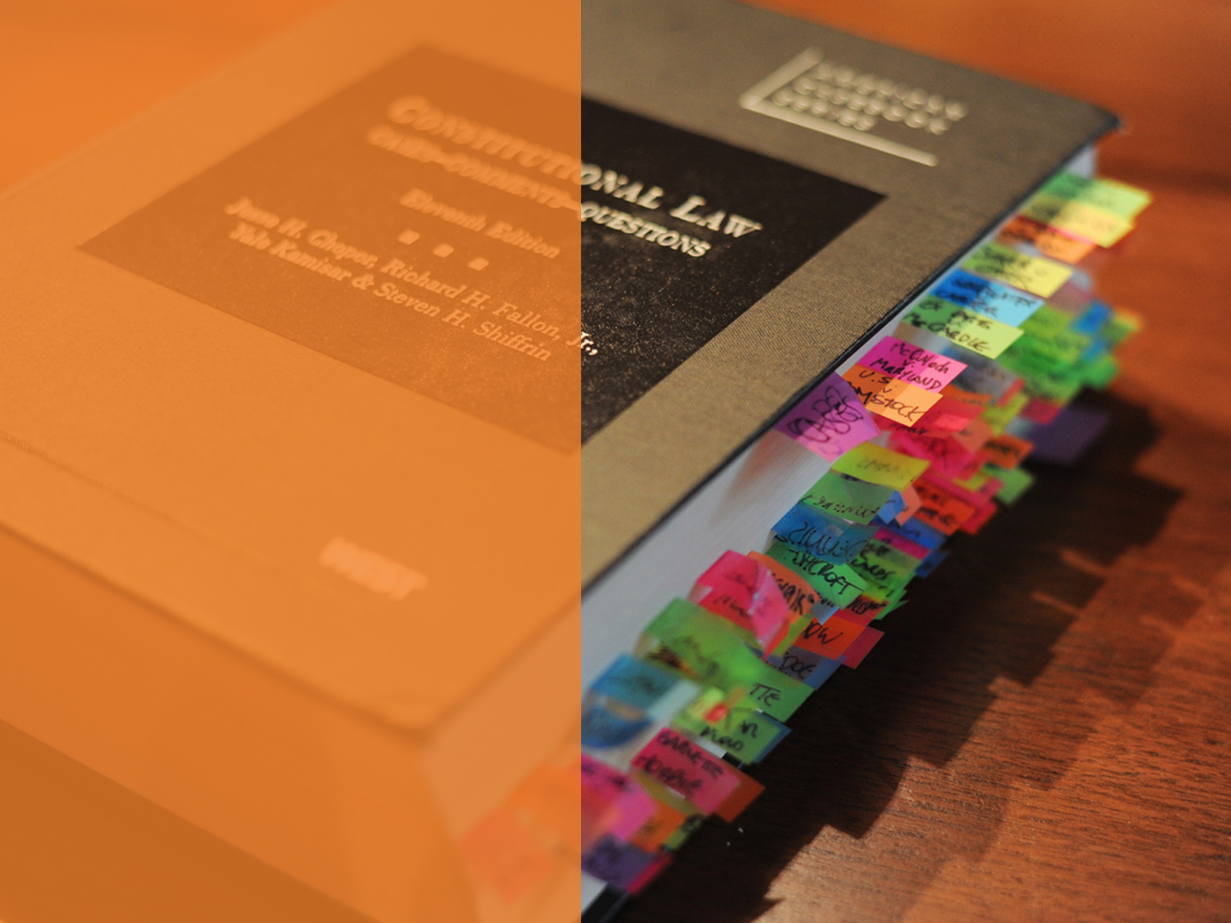
“Quote, copy content, or other information may be located here.”
December 15, 2015
Mitchell Hamline School of Law | 2

Slide 7
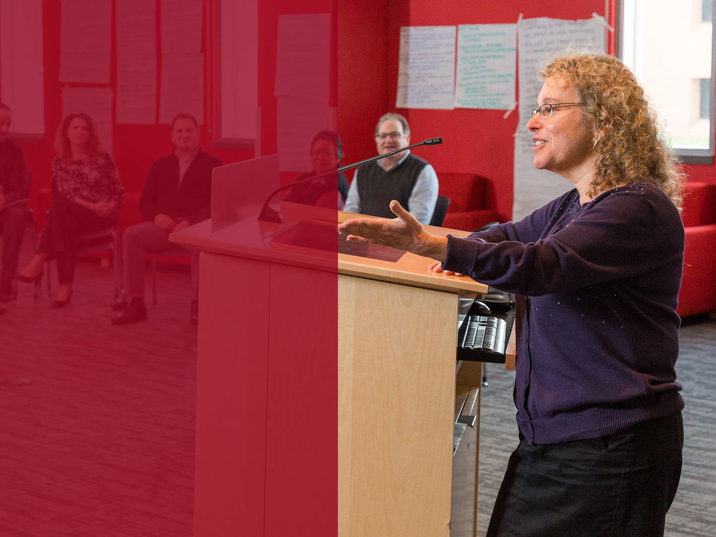
“Quote, copy content, or other information may be located here.”
December 15, 2015
Mitchell Hamline School of Law | 2

Slide 8

“Quote, copy content, or other information may be located here.”
December 15, 2015
Mitchell Hamline School of Law | 2

Slide 9

“Quote, copy content, or other information may be located here.”
December 15, 2015
Mitchell Hamline School of Law | 2

Slide 10
Slide title to go here.
THIS IS A SUBHEAD
Et modi am il magnimint restiuris volorum nonsedi ilicill uptatem et, ni beroreste pratur aditaqu.
Et modi am il magnimint restiuris volorum nonsedi ilicill uptatem et
December 15, 2015
Mitchell Hamline School of Law | 2

Slide 11
Slide title to go here.
THIS IS A SUBHEAD
Et modi am il magnimint restiuris volorum nonsedi ilicill uptatem et, ni beroreste pratur aditaqu.
Et modi am il magnimint restiuris volorum nonsedi ilicill uptatem et
THIS IS A SUBHEAD
Et modi am il magnimint restiuris volorum nonsedi ilicill uptatem et, ni beroreste pratur aditaqu.
Et modi am il magnimint restiuris volorum nonsedi ilicill uptatem et
December 15, 2015
Mitchell Hamline School of Law | 2

