Slide 1


Slide 2

December 15, 2015
Mitchell Hamline School of Law | 2

Slide 3

December 15, 2015
Mitchell Hamline School of Law | 2

Slide 4
December 15, 2015
Mitchell Hamline School of Law | 2

Slide 5

December 15, 2015
Mitchell Hamline School of Law | 2

Slide 6
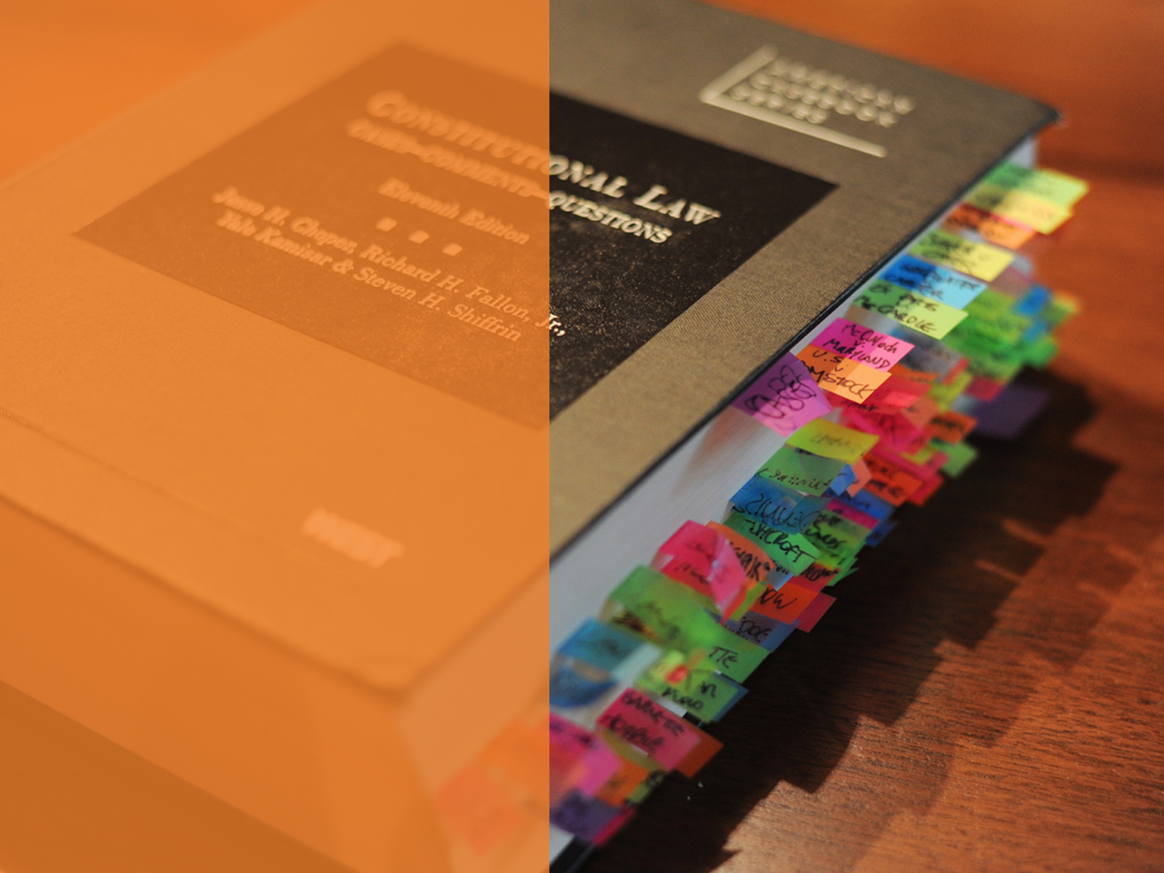
December 15, 2015
Mitchell Hamline School of Law | 2

Slide 7

December 15, 2015
Mitchell Hamline School of Law | 2

Slide 8

December 15, 2015
Mitchell Hamline School of Law | 2

Slide 9

December 15, 2015
Mitchell Hamline School of Law | 2

Slide 10
December 15, 2015
Mitchell Hamline School of Law | 2

Slide 11
December 15, 2015
Mitchell Hamline School of Law | 2

