Slide 1
Law Review Write-On: Case Note Research & Bluebook Tips
Sonya Huesman, J.D., M.L.I.S.
Research & Instructional Librarian
Spring 2018 (revised Spring 2020)

Slide 2
What is a Case Note?
Analysis of a decision in a specific case
Suggestion: Read prior case notes
http://open.mitchellhamline.edu/mhlr/
HeinOnline
Westlaw, Lexis

Slide 3
Law Review Archive
Library Website
Library Resources → Mitchell Hamline Open Access
Law Reviews and Journals
Select Mitchell Hamline Law Review for this past year’s issues
Select William Mitchell Law Review for prior issues

Slide 4
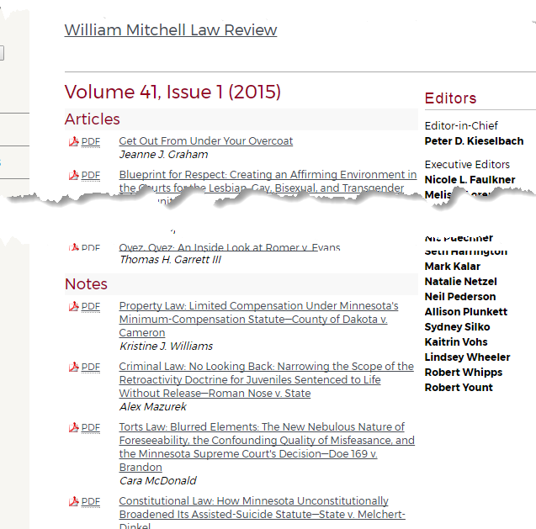
Law Review Archive
Notes for MHSL Law Review are in Issue 1.

Slide 5
HeinOnline
Library →Legal Research Resources → HeinOnline
White Log In button (upper right corner)

Slide 6
How Do I Start? What Do I Write About?
Once you get the case:
Read it 1x, 2x, 3x…
Identify what the issue(s) are that the court decided

Slide 7
Research with a Purpose
Plan
Identify the issues you need to know more about
Think about where you will look
Develop search terms (synonyms, broader/narrower)
Jurisdiction?
Minnesota
Do I need to look at others?

Slide 8
History of the Case
Dockets
Briefs
Oral Argument
Lower court disposition

Slide 9
Docket Minnesota Judicial Branch: http://www.mncourts.gov/

Slide 10
Docket MN Appellate Courts Case Management System http://macsnc.courts.state.mn.us/ctrack/publicLogin.jsp

Slide 11
Docket

Slide 12
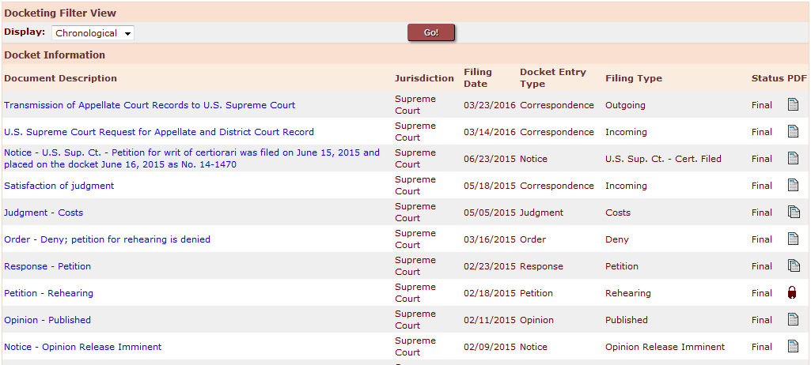
Docket

Slide 13
Briefs
Bloomberg (some on request)
- Look up case
Right column→ General Info→ “Related Dockets”
Scan and select briefs
“Request” documents
Info on potential cost (we don’t pay, won’t get if there is a charge)
Litigation & Dockets tab
Docket Requests
Westlaw
Look up case
“Filings” tab
Note: if the case has been appealed you will see U.S. Sup. Ct. filings as well.
Lexis (some)
Some briefs
Look up case
Right column, under Shepard’s
Related Court Materials

Slide 14
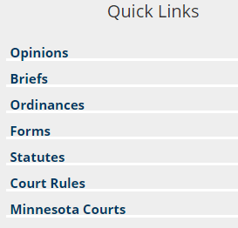
Briefs
Minnesota Judicial Branch: http://www.mncourts.gov/
Access Case Records, etc.
Minnesota State Law Library http://mn.gov/law-library/
Quick Links box on right column
Briefs link
Not very sophisticated search function

Slide 15
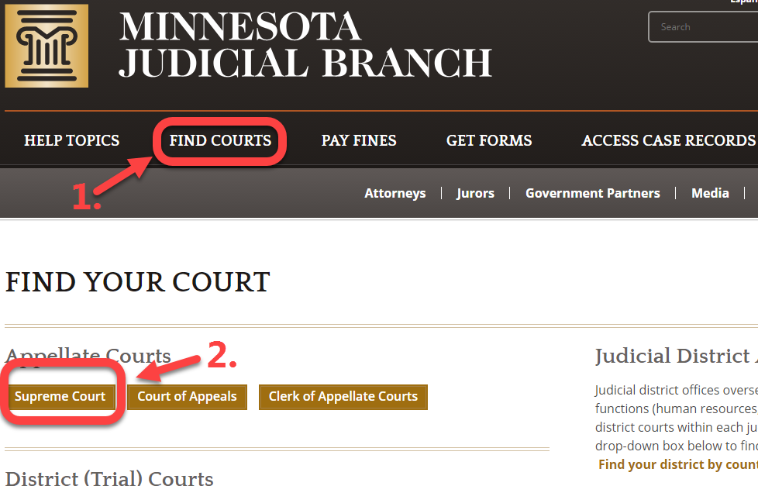
Oral Arguments
Minnesota Judicial Branch: http://www.mncourts.gov/
Find Courts → Supreme Court

Slide 16
Oral Arguments

Slide 17
Minnesota Research Resources
Dunnell Minnesota Digest
Minnesota Legal Periodicals
Minnesota CLE publications
Legal Blogs (Blawgs)

Slide 18
Dunnell Minnesota Digest: an encyclopedia of Minnesota law
Called a digest (which is a finding tool for cases) but it is also an encyclopedia.
Locations:
Reference Collection: KFM 5465.D93 6th ed.
Lexis

Slide 19
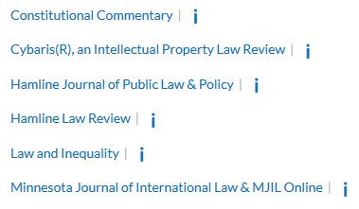
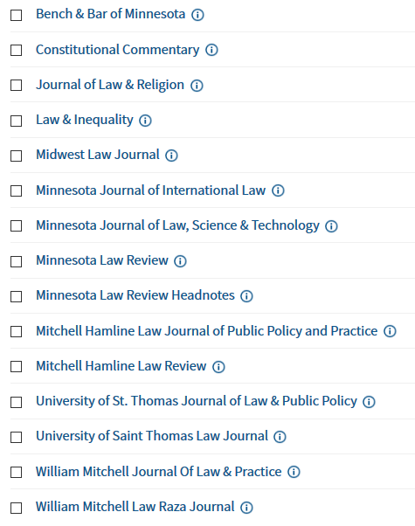
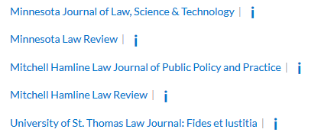
Minnesota Legal Periodicals
Lexis
Westlaw

Slide 20
Minnesota Legal Periodicals Index
Library →Legal Research Resources → Databases A-Z → Minnesota Legal Periodicals Index
Freely available to public users

Slide 21
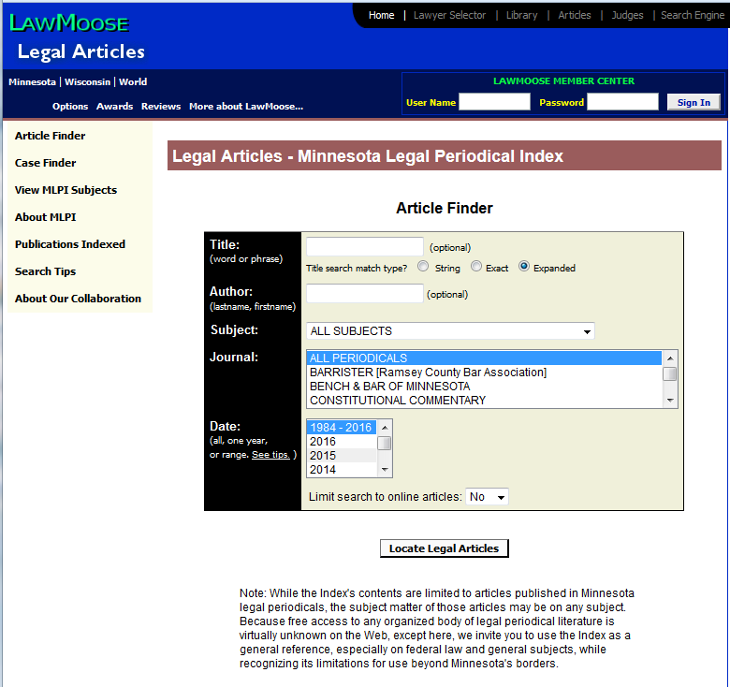

Slide 22
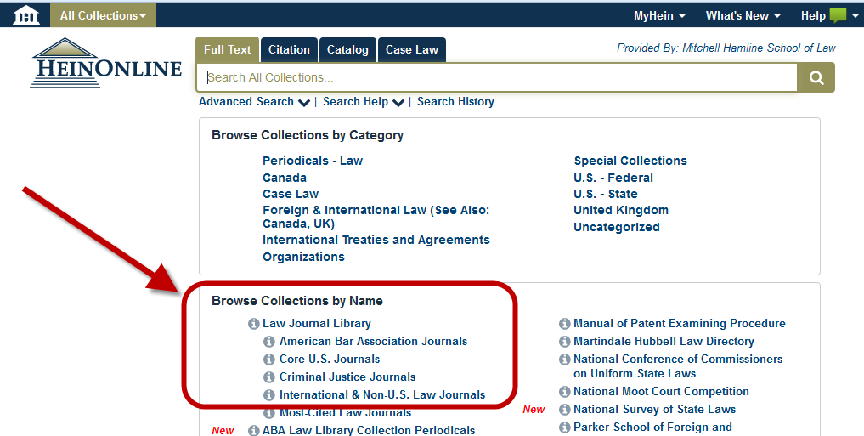
Hein Online
Library → Online Research Resources → HeinOnline
White Log In button (upper right)

Slide 23
Minnesota CLE’s
Library Catalog
keyword searches CLE titles and chapter titles
MN CLE
Library website → Databases A-Z → Minnesota CLE Materials

Slide 24
Legal Blogs (Blawgs)
Articles/Commentary written by practitioners on current topics
Where to find:
Justia Blawg Search – topical, jurisdictional
http://blawgsearch.justia.com/blogs/countries/united-states/minnesota
ABA Blawg Directory –
http://www.abajournal.com/blawgs/

Slide 25
Beyond Minnesota: American Law Reports (ALRs)
Looks at issues in depth and in many jurisdictions
Westlaw & Lexis

Slide 26
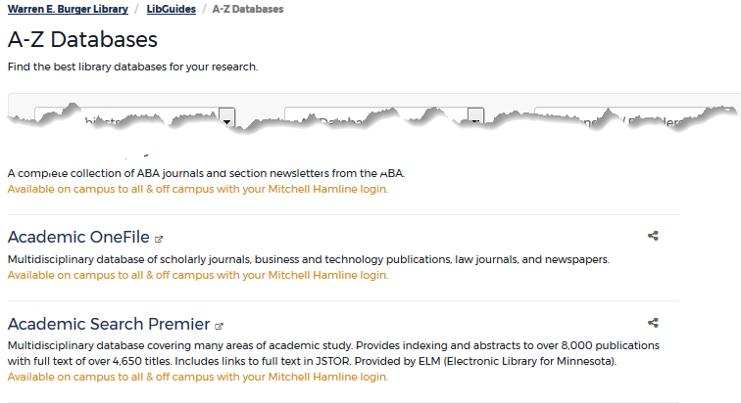
Beyond Minnesota: Multidisciplinary Databases
Multidisciplinary: social science, education, health, religion, etc.
Academic Search Premier/Academic OneFile
Library→ Legal Research Resources→ Databases A-Z

Slide 27
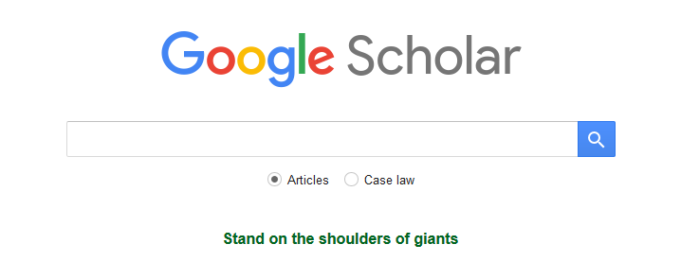
Beyond Minnesota: Google Scholar
https://scholar.google.com/
Focus on academic,
scholarly materials

Slide 28
Beyond Minnesota: Social Science Research Network
http://www.ssrn.com/en/
multi-disciplinary online repository of scholarly research and related materials.
Created as pre-publication site for authors to get feedback
Now has post-publication material as well

Slide 29
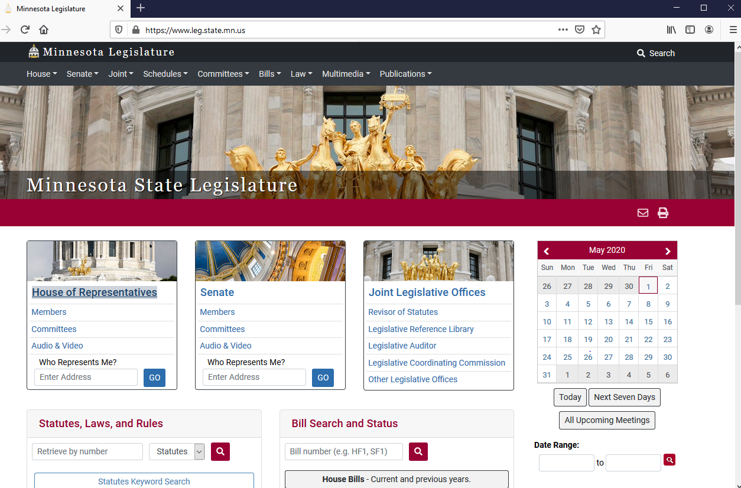

Slide 30
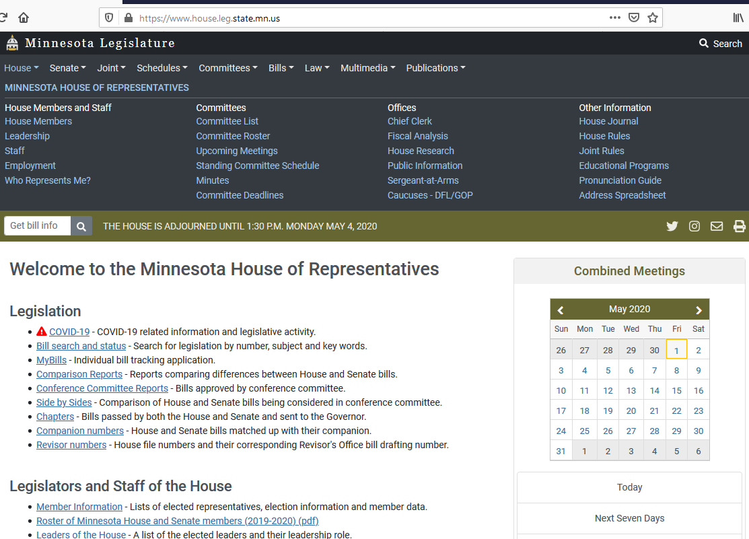
Legislation Based Resources
Research Reports
House:
Senate:

Slide 31
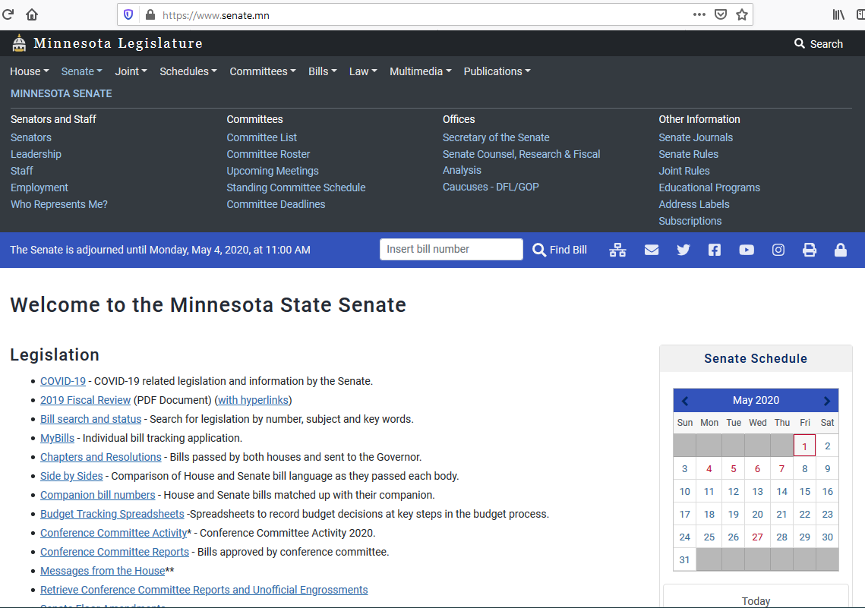

Slide 32
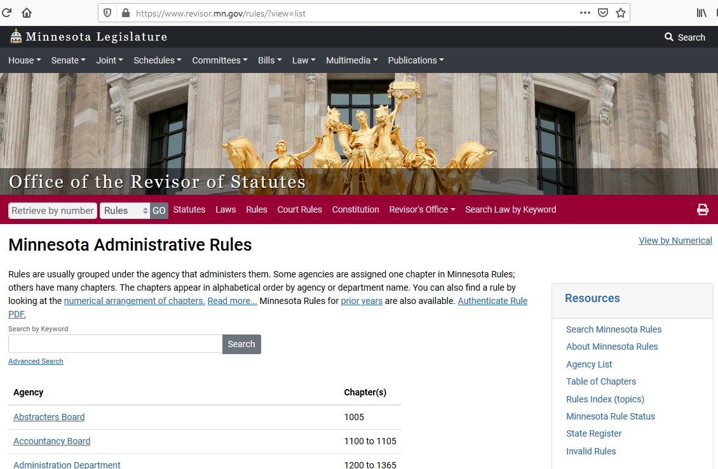
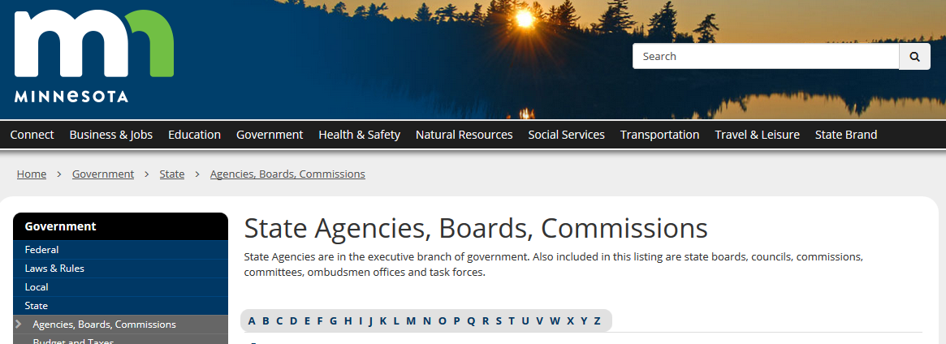
Administrative Agencies
Rules:
Westlaw, Lexis,
Minnesota State Legislature
Administrative Agency websites
Google for agency
Full listing: https://mn.gov/portal/government/state/agencies-boards-commissions/

Slide 33
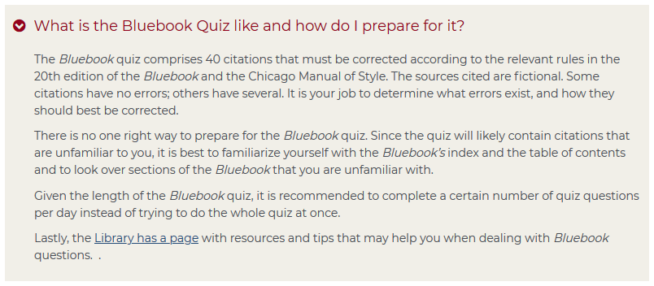
Bluebook Quiz

Slide 34
Bluebook Quiz - Preparation
Review the structure of the Bluebook
No more Bluepages, now focusing on Whitepages
Review the Table of Contents – what does it cover? how is it organized?
Read the Introduction (pp. 1-2)
Review Rules 1-9 (pp. 57-94)

Slide 35
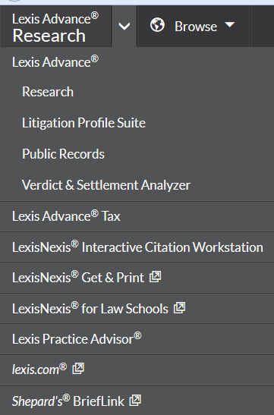
Bluebook Test - Preparation
Test yourself: LexisNexis Interactive Citation Workstation
Sample citations, hints with Rule numbers when you get them wrong.
State specific section as well

Slide 36
Online Bluebook Subscription

Slide 37
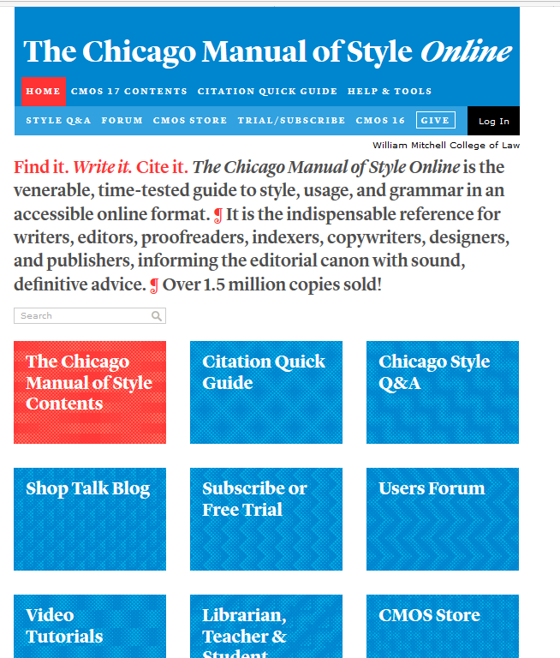
Chicago Manual of Style
Library →
Legal Research Resources →
Databases A-Z →
Chicago Manual of Style

Slide 38
Bluebook Test – Taking
Don’t leave it to the last minute…
If you are unsure, look to see how others have cited it

Slide 39
Can I get help?

Slide 40
Questions?

