Slide 1
Designing better sexual harm prevention
Eric S. Janus
Hartford Connecticut
December 2018

Slide 2
S.C. Attorney General Henry McMaster:
“I promise you out there right now, it is raining perverts. They’re all over the place. They’re trying to get into your children.”(2007)

Slide 3
Consider

Slide 4
Smith v. Doe, 538 U.S. 84, 103 (2003).
“The legislature's findings are consistent with grave concerns over the high rate of recidivism among convicted sex offenders and their dangerousness as a class. The risk of recidivism posed by sex offenders is "frightening and high." …When convicted sex offenders reenter society, they are much more likely than any other type of offender to be rearrested for a new rape or sexual assault.”

Slide 5
Myths are dangerous
Misdirect our law and policy

Slide 6
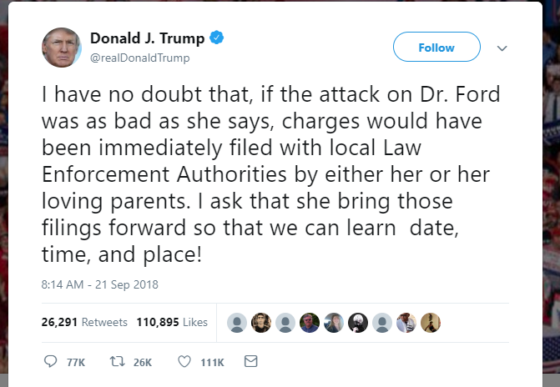
Myths are dangerous
Rape myths
Sex offender myths

Slide 7
Department of Justice Study – offenders released in 1994
9,691 sex offenders from fifteen states
Three-year follow up
Almost 95% were not arrested for a sex offense.
Recidivism for a new sex crime was 5.3%

Slide 8
Myths, frames, and questions
The myths have misled us.
Created a set of frames and questions.
Misallocation of resources, ineffective policies, unintended consequences, and dangerous legal principles.

Slide 9
Plan
Where has reliance on this myth led us?
  Frames and questions
Why is there so much stickiness in these frames?
How have the frames misdirected us?
How should we change our frames to improve our efforts?

Slide 10
Fundamental point
We’ve been asking the wrong questions and getting the wrong answers.
  Who is the most dangerous?
We should be asking:
  How can we prevent the most danger?

Slide 12
“Victim advocacy organizations have questioned the large expenditure of funds on sex offender management tools that may not really protect communities, while resources and services for victims are being cut”

Slide 14
Jeanne Ronayne, Executive Director at MNCASA expressed that “We extend our care and concern to the victim/survivors who suffer the long-term consequences of sexual violence. Their safety and wellbeing must be first and foremost in our minds. Equally important is our collective commitment to prevention of sexual violence in all its forms. Ending sexual violence is urgent and highly complex. The hope and promise of prevention of future violence requires tools beyond those available to our civil or criminal justice systems which can only respond after harm has occurred.”
Public safety is served by prevention and true rehabilitation. A dysfunctional system does not help victims, and it does not help public safety. When criminal justice and civil commitment systems do what they are supposed to do, victims are respected, constitutional rights are upheld and public safety is not compromised.

Slide 15
Prevention
Should be our focus; our common ground

Slide 16
A short history
Rape laws and practice shaped by rape myths
Feminist reforms of rape law, criminal justice practices
  Redefinition of rape and sexual assault.
  New understanding of rape and sexual assault.
  Changes in how victims are treated in the c/j system.
New regulatory laws beginning the in the 1990s
  Registration
  Public notification
  Residential banishment
  Civil commitment

Slide 17
But …
#MeToo
Penn State; Ohio State, elite schools

Slide 18
What are we trying to accomplish through our laws and policies? What tools?
Condemnation?
Revenge?
Prevention?
Reporting?
Crime solving?
Support of victims?
Changing “rape culture”?
Punishment?
Supervision?
Treatment?
Reintegration?
Separation?
Shaming?

Slide 19
How have we gone wrong? Where should we be going?
Too narrow a focus.
Downstream focus.
Ignoring evidence.
Asking the wrong questions.
Reactionary not comprehensive or systematic.
Dangerous legal principle.
Comprehensive and systematic
  Primary, secondary and tertiary
Seek root causes
Evidence-based
Assess
Replicate best practices

Slide 20
“Frightening and high” myth - consequences
Almost all sex offenders will repeat their offenses.
Sex offenders as a class are extremely dangerous.
Sex offenders are “wired differently”.
Sexual violence is a problem caused by abnormal psychology (or biology).
Highly rare crimes are seen as archetypes. “The sexual predator”.
Sex offenders are the “other”, are monsters.
Stranger danger model.
We should identify these dangerous people and keep them away. This should be our primary concern.

Slide 21
Myth: Almost all sex offenders recidivate: the serial predator model.
Non-recidivists
First-time offenders
Current
Sex offenders
Future
Sex offenders

Slide 22
Where does this lead?
Downstream focus.
Ignore root causes.
Cast majority of sexual violence into the shadows.
Degraded other: their pain does not count.
Stunted metric: if one victim is saved …
Spare no expense.
Ignore opportunity costs.
Ignore unintended consequences.
Ignore science – low burden of proof. No accountability for policy choices.

Slide 23
How did we get here?
The culture wars?

Slide 24
Culture wars …
Sexual violence is ubiquitous.
Societal norms allow it to flourish.
Women and children are most at risk in domestic and familiar settings.
Sexual violence is stranger violence.
Women and children are safest at home, under the protection of the family.
Sexual violence is aberrational and abnormal.

Slide 25
Culture wars …
“Collectively, women are more at risk of violence in intimate relations than in public spaces.”
  Elizabeth Stanko
“The institution that most strongly protects mothers and children from domestic abuse and violent crime is marriage.”
  Heritage Foundation

Slide 26
Culture wars …
It’s us.
It’s them.

Slide 27
The shortcomings of the “them not us” framework.
Nancy Sabin, Executive Director of Jacob Wetterling Foundation
  “We keep getting sidetracked with issues like castration and pink license plates … But these people are coming from us – society – and we have to stop the hemorrhage. We have to stop pretending that these people are coming from other planets.”
Donna Dunn, former Executive Director of the Minnesota Coalition against Sexual Assault:
  “The absence of critical thinking about the larger social context … short circuits strategies that could address this problem at its roots”

Slide 28
How we have been misdirected.
The myth of “frightening and high”

Slide 29
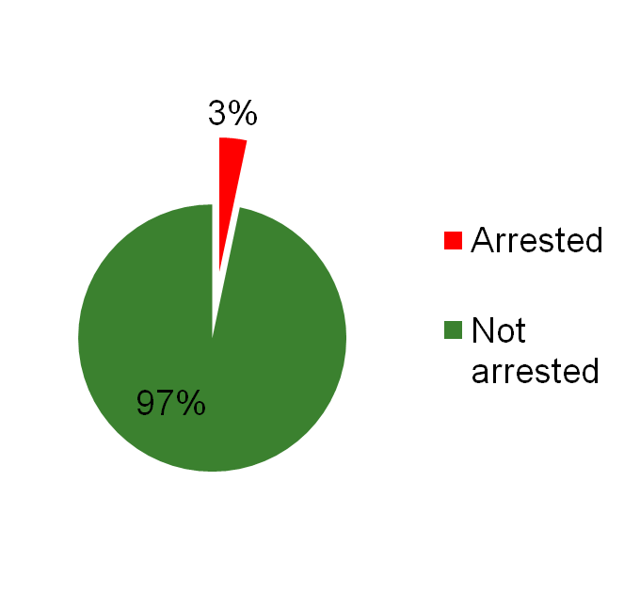
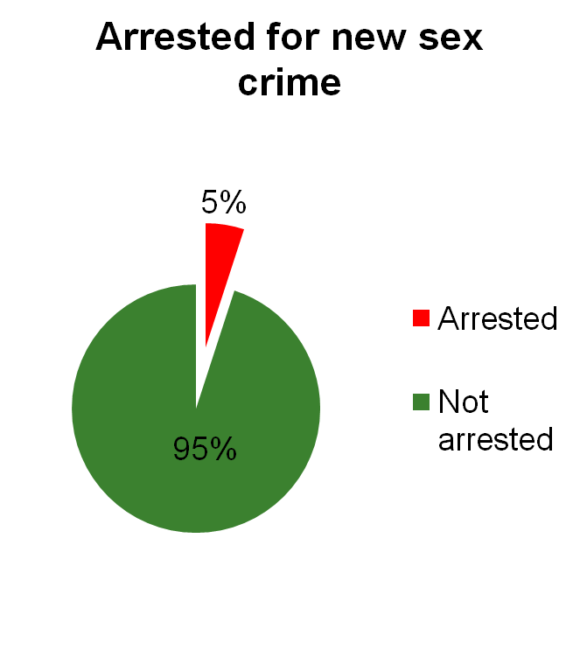
1. Sex offender recidivism is well below the myth
Child molester
sexual recidivism
Source: BJS SO’s released in 1994. 3-year recidivism.

Slide 30
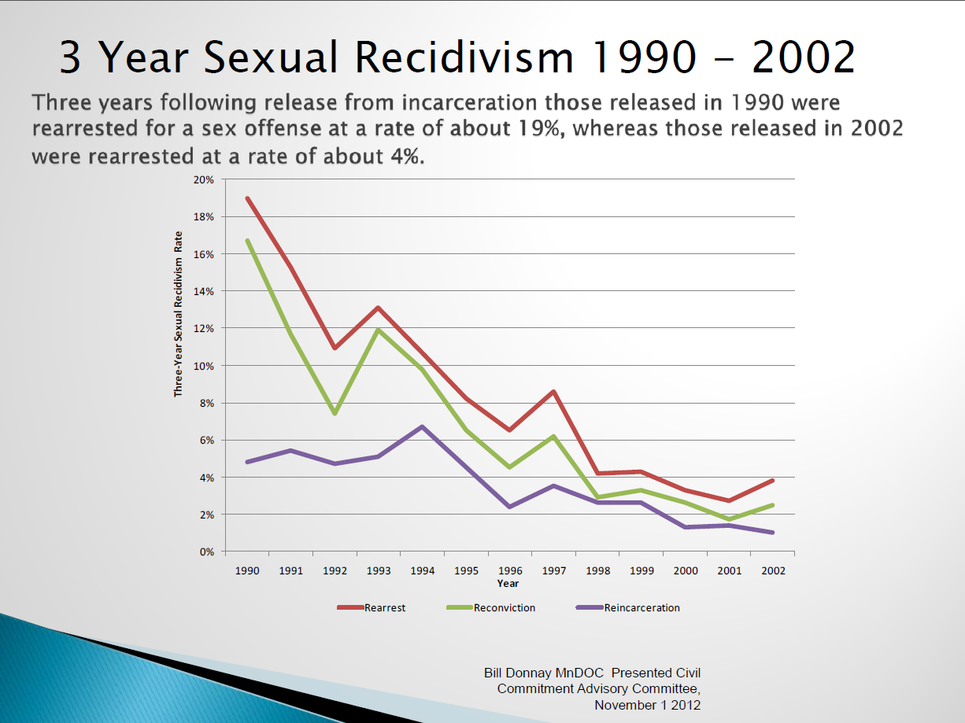
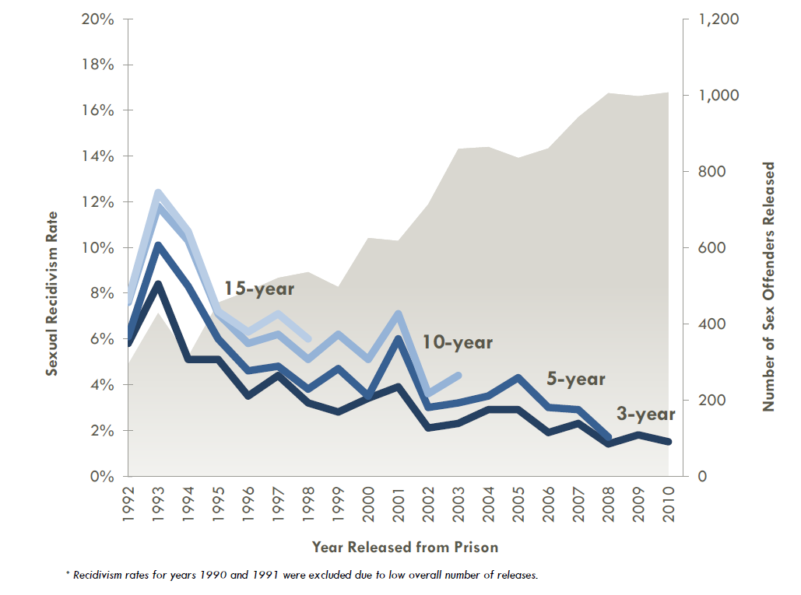
2. Measured recidivism rates have declined

Slide 31
3. Risk is not “average” for most offenders
Source: Seung C. Lee, R. Karl Hanson, Nyssa Fullmer, Janet Neeley &
Kerry Ramos, The Predictive Validity of Static-99R Over 10 Years
for Sexual Offenders in California: 2018 Update, SARATSO 19,
http://saratso.org/pdf/Lee_Hanson_Fullmer_Neeley_Ramos_201
8_The_Predictive_Validity_of_S_.pdf.
Source: Brian Collins, MN DOC, 2017

Slide 32
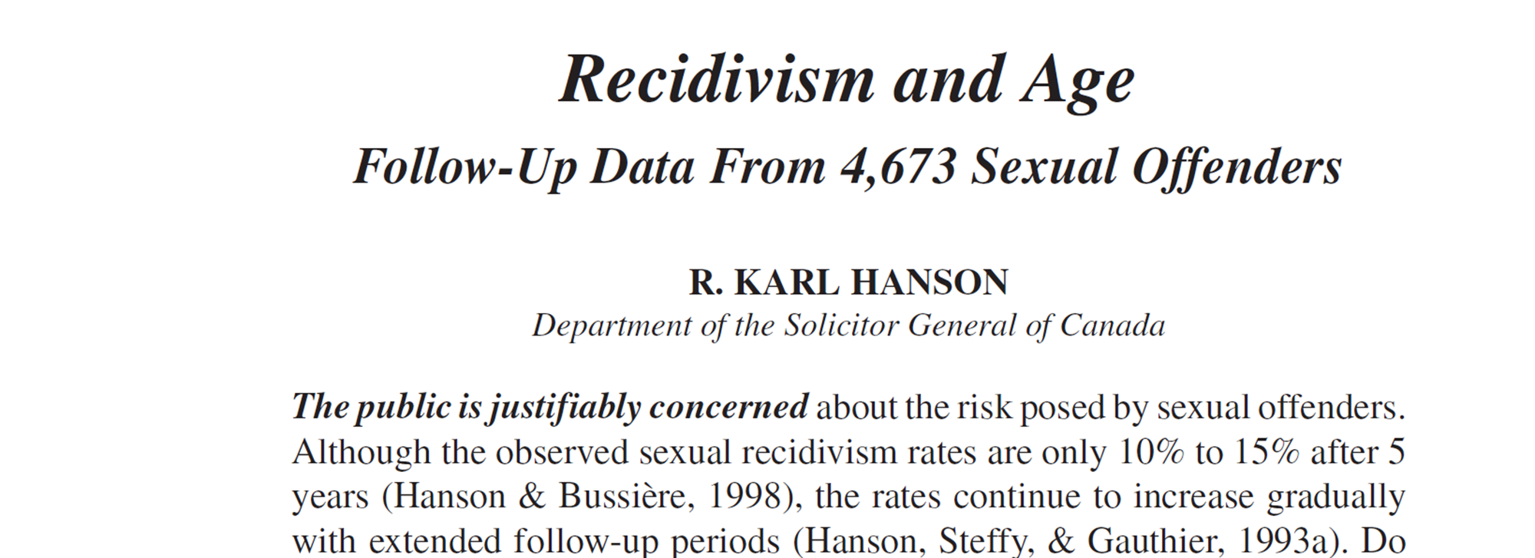
4. Risk declines with age.
Age-related “reductions in recidivism among sex offenders are consistent across studies….”
The “aging effect” as “one of the most robust findings in the field of criminology.”
ROBERT A. PRENTKY, HOWARD E. BARBAREE AND ERIC S. JANUS, SEXUAL PREDATORS: SOCIETY, RISK AND THE LAW (ROUTLEDGE, 2015) at 106-113

Slide 33
5. Risk declines with time offense-free in the community
Important policy implications

Slide 34
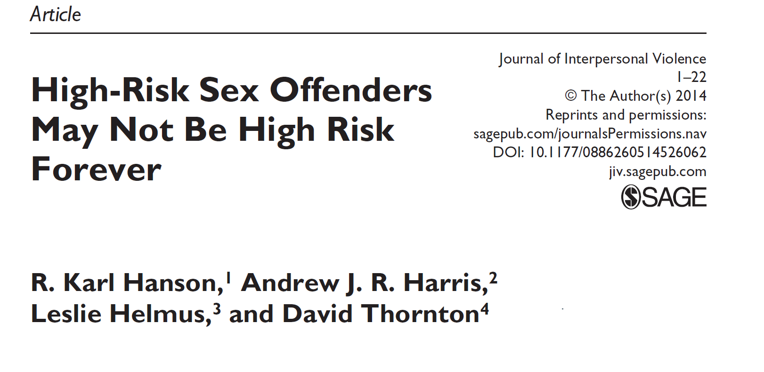

Slide 36
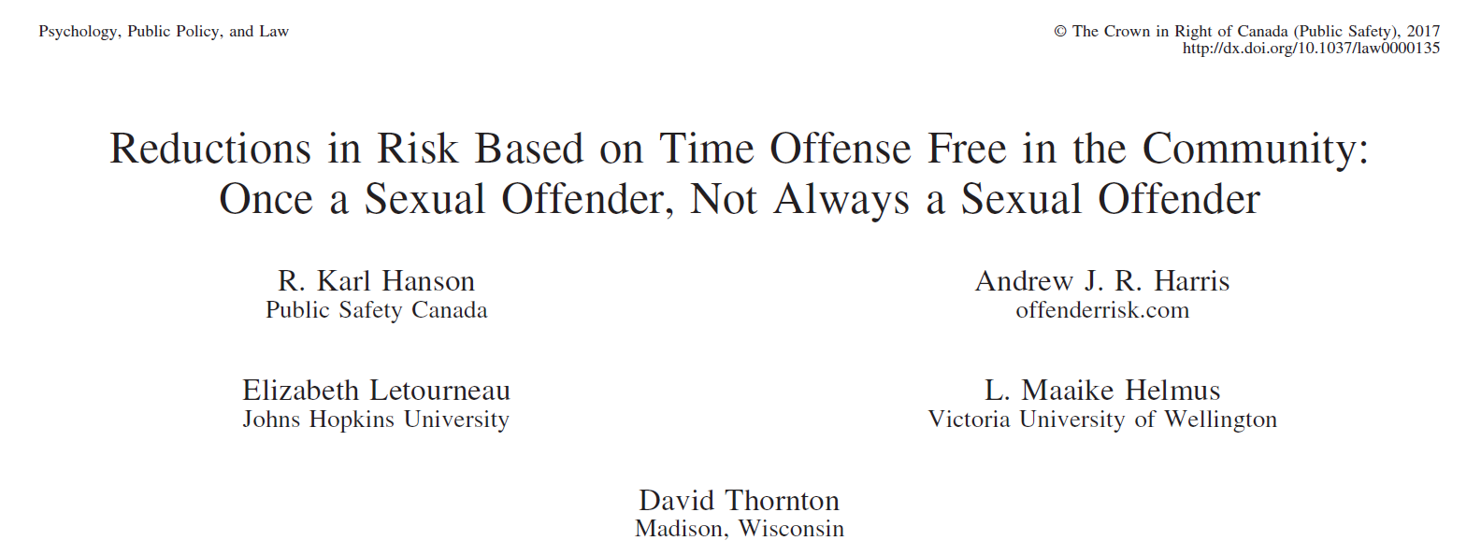

Slide 38
6. Recidivist sex offending is a small part of sexual offending.

Slide 39
Most imprisoned sex offenders are not sexual recidivists
Source: BJS Study of Sex Offenders released in 1994.
Notes:
BJS Study of Sex Offenders released in 1994.

Slide 40
Most SO Convictions are first-time offenders

Slide 41
Most SO Arrests are first-time offenders
Source: Scholars’ Brief, citing Jeffrey C. Sandler et al., Does
a Watched Pot Boil? A Time-Series Analysis of New York State’s
Sex Offender Registration and Notification Law. 14 PSYCHOL., PUB.
POL’Y & L. 284 (2008) (In N.Y., 95% of sex-offense arrestees
between 1986 and 2006 were first-time sex offenders.).

Slide 42
Recidivist violence is a small sliver. The serial predator model is wrong.
Current
Sex offenders
Future
Sex offenders

Slide 43
Sexual Violence – the stream
Recidivist violence
Root causes
Note: Figures are derived from various sources; some are
estimates. Chart is for illustrative purposes only.
Notes:
Figures for reports to police and cleared are for 1997 and are from Minnesota planning dept. Sex offenses (leftmost column) is estimate based on fact that about 50% of offenses are reported. Convictions is from 1992 and 1991 figures, and combines juvenile and adult, and comes from OLA Sex Offender Treatment Programs report. Probation is derived as follows. The OLA report says most juveniles s/o were given probation, and 70% of adults. So, I have estimated that 558 adults (.7*798) and 600/654 juveniles were on probation

Slide 44
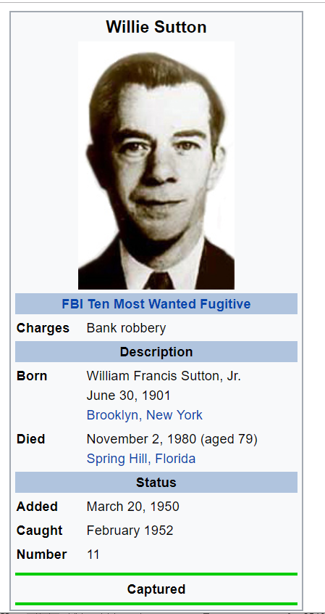

Slide 45
Misdirects our attention
Small sliver of the problem.
Ignore root causes.
Submerge sexual violence that does not fit the archetype.

Slide 46
Effective?
Compared to what?

Slide 47
SORN - Effective?
Mixed results among studies on reduction of recidivism.
Some deterrent effect detected.
Some negative effect on criminal justice system behavior.
Clear statistical evidence of perverse increase in recidivism from aggressive laws.
Increase in recidivism may offset deterrent effect.

Slide 48
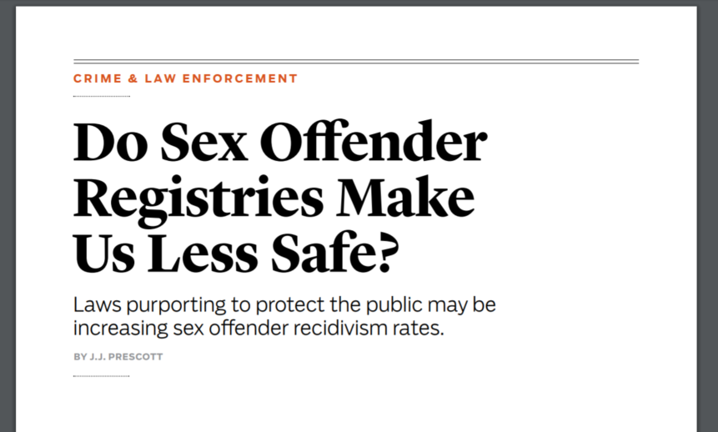
Notification may increase recidivism -
All else equal, publicly revealing the identity and criminal history of a released offender seems to increase the likelihood of his returning to crime. These results are highly statistically significant: it is unlikely that existing notification laws are reducing recidivism among registered offenders, and it is distinctly possible that these laws are making things worse (Prescott, 2012, p. 54).

Slide 49
MN Residency Restriction Study (2007)
3,166 offenders released between 1990-2002
224 sexual reoffenses
Residency restrictions would not have prevented any of these offenses
Not one of these offenses was related to the offender’s residential proximity to a school, daycare, or park
(Minnesota Department of Corrections, 2007)

Slide 50
Other perverse consequences?
Do these policies do harm?

Slide 51
ATSA – depress reporting?
“It is important to consider whether or not the legislative policies currently enforced to manage known sex offenders might play a role in reducing the reporting of sexual abuse as opposed to there being an actual decline in the incidence of child sexual abuse”

Slide 53


Slide 54
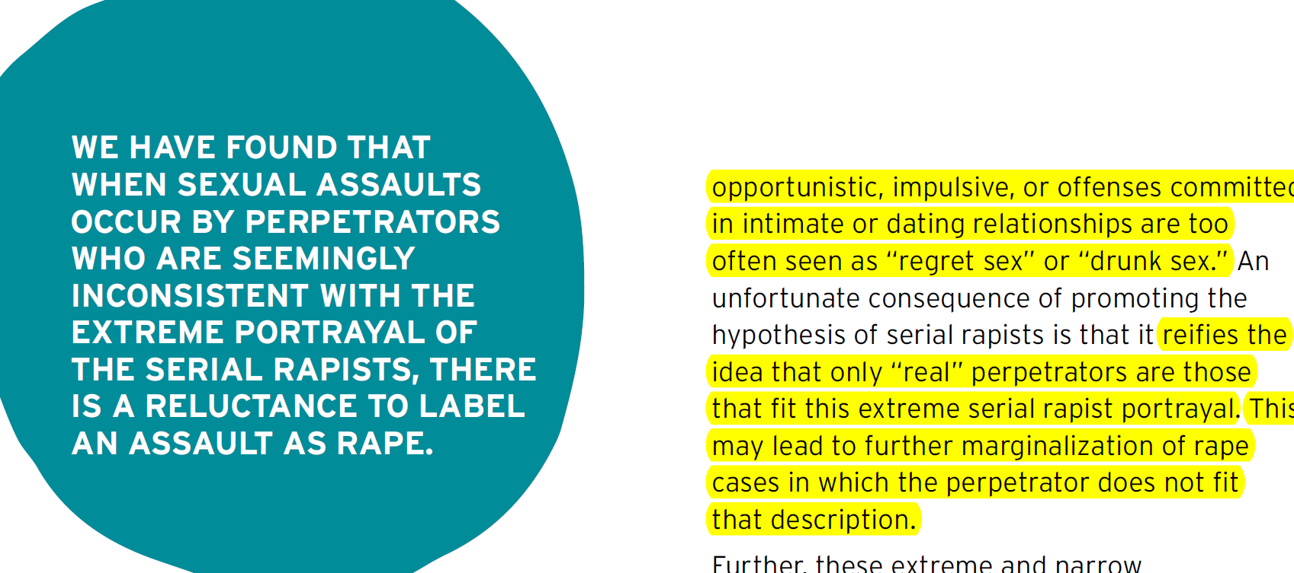

Slide 55
Allocation of resources.

Slide 56
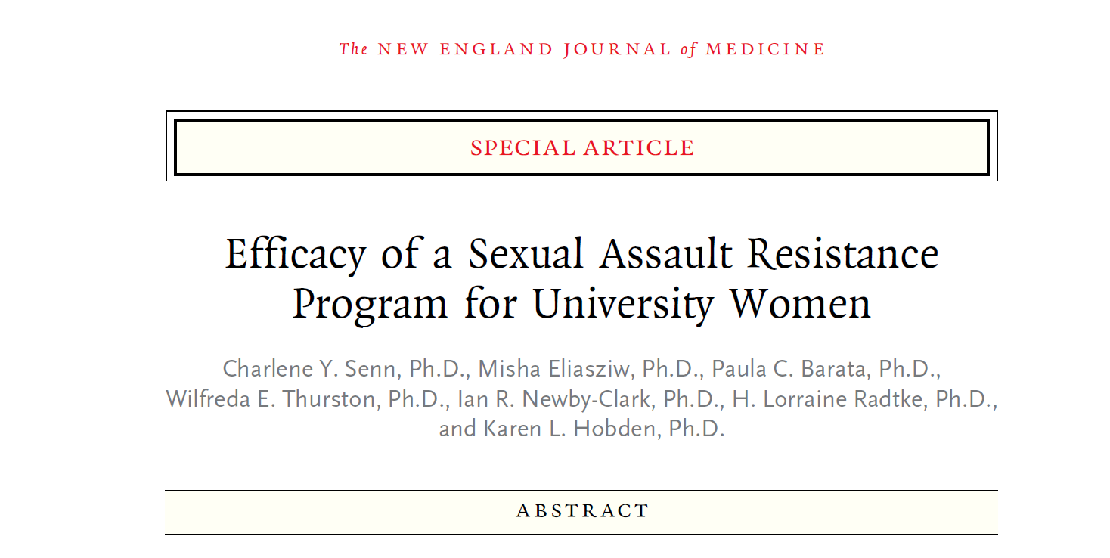
Rigorous study.
Reduced incidence of both sexual assault and rape (by 50%).

Slide 57
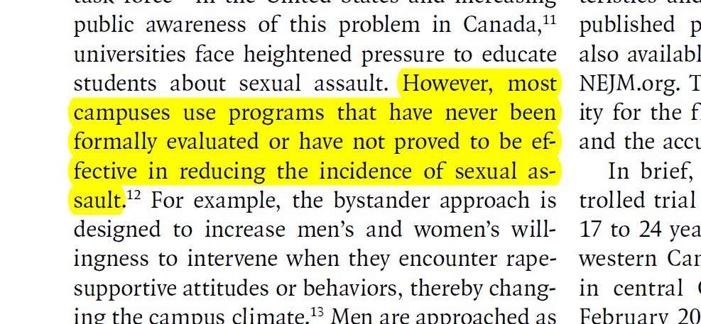

Slide 58
Domestic Violence Prevention and Services
CT Coalition Against Domestic Violence:
246 intimate partner homicides in CT between 2000 and 2017.
8% cut in staff; double digit increase in service demand.
“There is great concern about the prospect of additional cuts at both a state and federal level.”

Slide 59
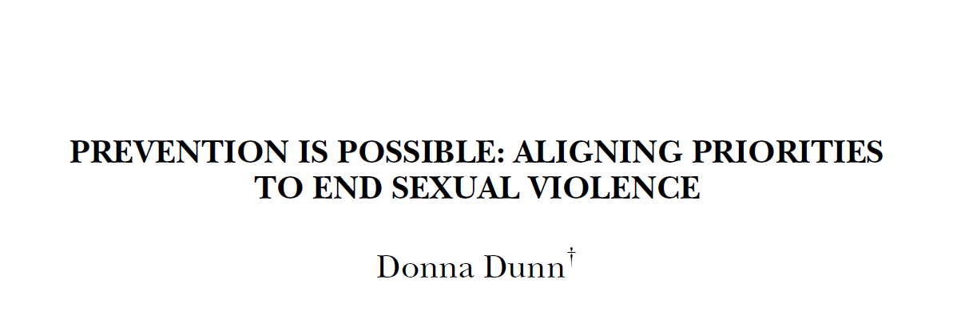

Slide 60
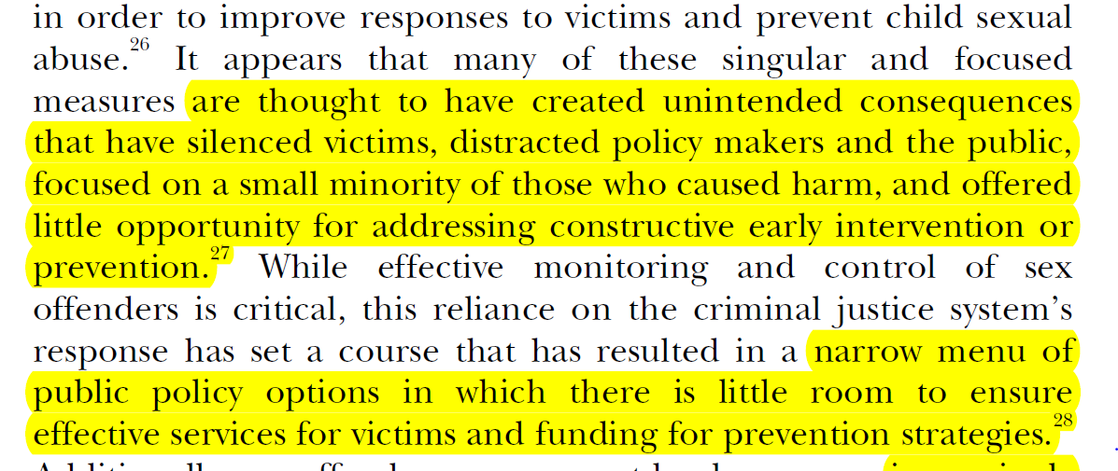

Slide 61
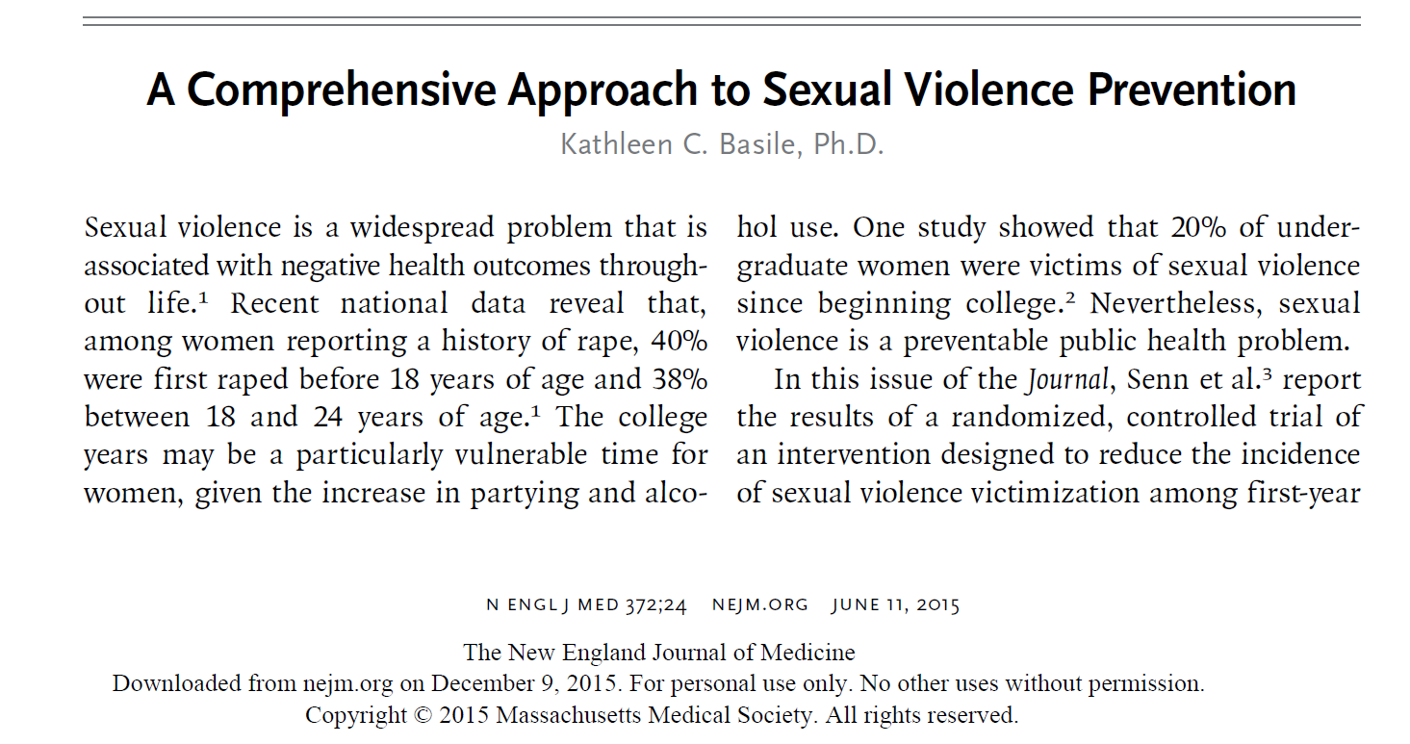

Slide 62
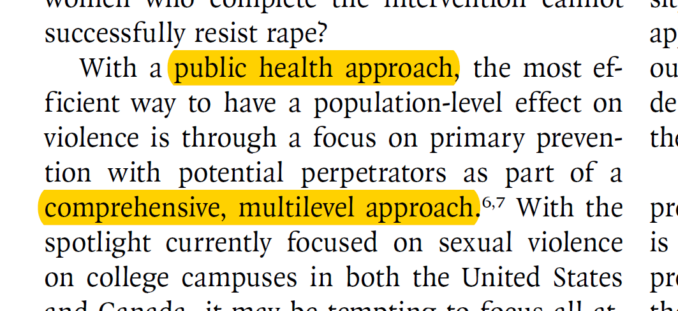

Slide 63
Public health approach
Comprehensive and systematic
  Primary, secondary and tertiary
Seek root causes
Evidence-based
Assess
Replicate best practices

Slide 64
Public health approach
“If a strategy is widely implemented, even a small effect on perpetration behavior may have a large impact.” DeGue et al. (2014).

Slide 65
Thought experiment
Suppose 1000 arrests/year.
Two choices:
  Reduce recidivism by 10%
  Reduce first-time offending by 1%.
Recidivist: 1000*5% = 50
10% reduction: 5
First-time = 950
1% reduction = 9.5

Slide 66
Our current frames push us far downstream
Current frames
New frames
Recidivism
“Most dangerous”
The “sexual predator”
Small group of abnormals
Excise the cancer
Spare no expense
Degraded “other”
Look at the data
Where is the danger
Root causes
Owning the problem (us vs. them)
Humane
Most effective use of resources
Public health approach

Slide 67
Implications for the registry
Is it a sound policy?
Is it focused or overbroad?
Is it a smart allocation of resources?
Are barriers to reintegration minimized?
Does it take into account the evidence?

