Slide 1
2021 HCBA 1L Minority Clerkship Information Session
Diversity and Inclusion Committee,
Hennepin County Bar Association (HCBA)

Slide 2
Why I'm here today!

Slide 3
1L Minority Clerkship Program
Program places first-year minority law students with Minnesota legal employers for a paid summer legal experience
In 2020, over 50 students applied
14 were accepted to the Program

Slide 4
2018 Summer Employers
4th Judicial District Court
Bowman & Brooke
Brown & Carlson P.A.
Chestnut Cambronne
Felhaber Larson
General Mills/Littler
Hennepin County Attorney’s Office
Hennepin County Public Defender’s Office
Messerli Kramer
MN Attorney General’s Office
MN Department of Commerce
MN Department of Transportation
Schaefer Halleen

Slide 5
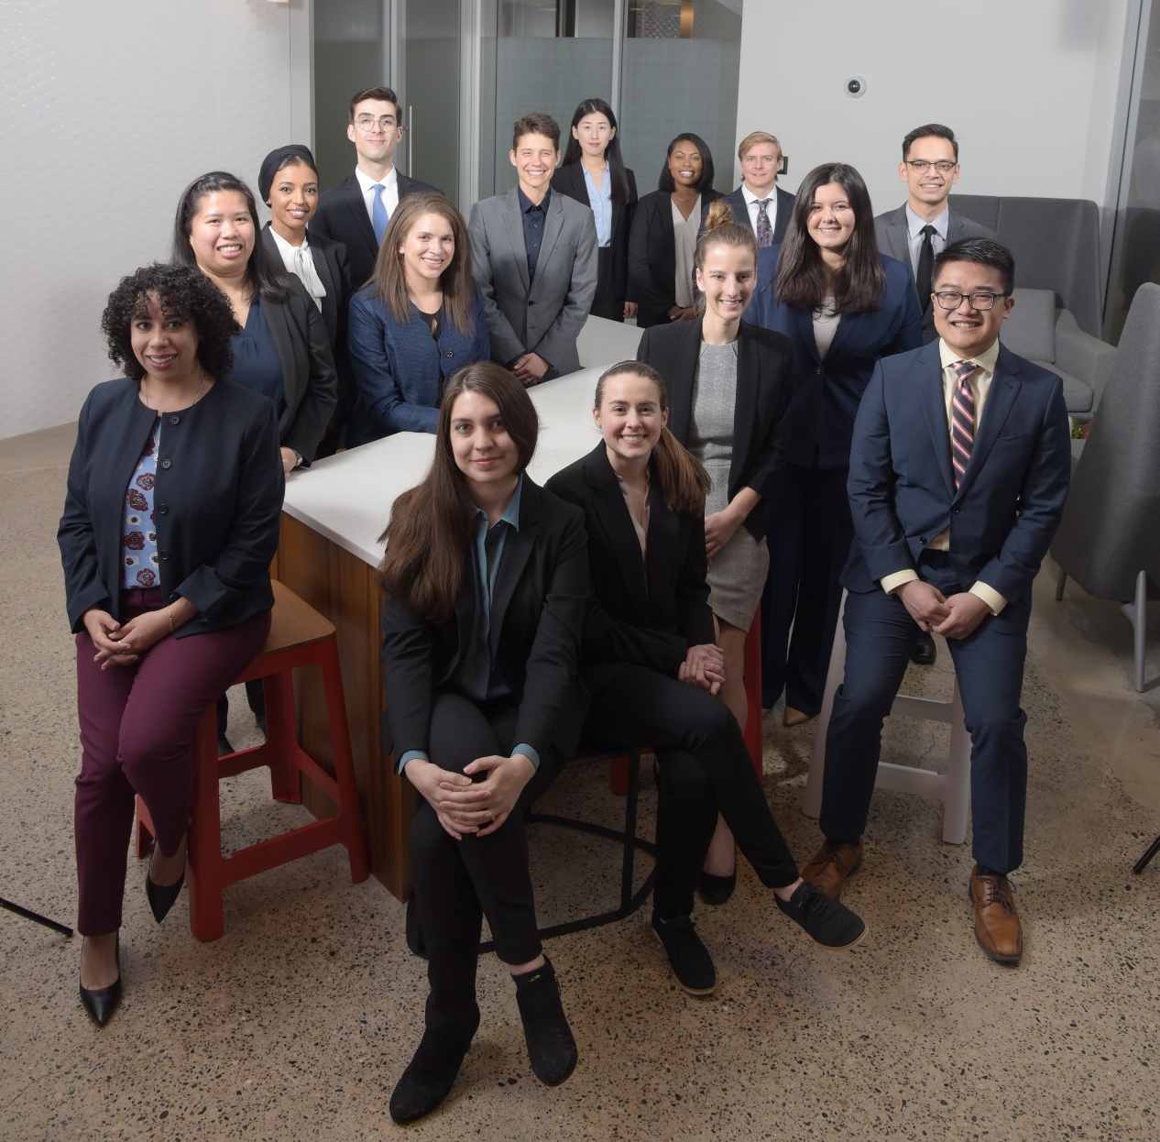
2020 HCBA 1L Clerks

Slide 6
How Program Works (1 of 2) (see Handout)
Apply by deadline (Nov. 30th)
Each applicant is guaranteed an initial interview
Select few are accepted to the Clerkship Program
# Law Clerks is based on # of employers
Law Clerks accepted to the Clerkship Program are guaranteed paid summer employment!

Slide 7
How Program Works (2 of 2) (see Handout)
Law Clerks have 20-minute interview with each employer
Rank choices (first to last)
Blind match
Law Clerks attend ½ day orientation
Law Clerks work with employer for 8-12 weeks in summer

Slide 8
What you'll be doing
Legal work for 8-12 weeks
You'll be mentored
You'll receive performance feedback
Attend networking events

Slide 9
Timeline
Nov. 30, 2020: Application deadline
Jan. 3, 2021: Writing sample emailed
Jan. 4 – Jan. 8, 2021: Initial interviews
Feb. 8 – 12, 2021: Matching interviews with employers
Submit first semester law grades
Feb. 19, 2021: Matching preference forms due
March 1, 2021: Employer/student matches announced
April 9, 2021: 1L Summer Clerkship Orientation

Slide 10
How to Apply
Application is at
https://mnbar.wufoo.com/forms/1l-minority-clerkship-program/
You'll need to upload (in one single PDF)
Resume
Personal statement
Undergraduate transcript with GPA (unofficial)
Legal writing sample
Select interview time on application page

Slide 11
Transparency

Slide 12
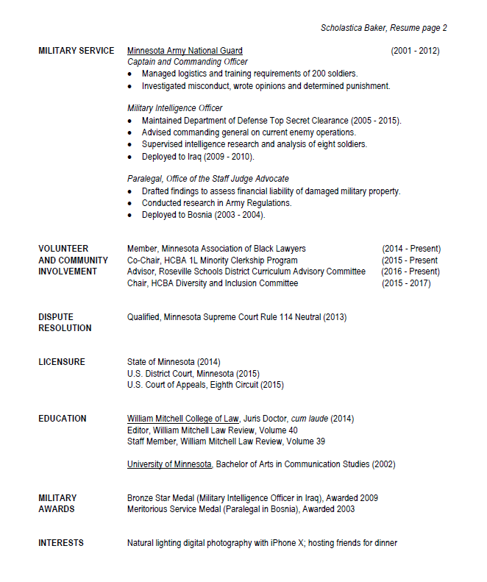
Resume
Highlight accomplishments; not a novel
No typos
White space is good
2 pages, only if necessary
Interests section
Be specific
Great conversation starter at interview

Slide 13
Personal Statement (1 of 3)
3-part substantive question.
Your personal statement must discuss:
How your identity, background, culture, or life experience makes you unique;
How your unique perspective will add value to the legal community; and
What motivates you to stay and practice law in Minnesota.

Slide 14
Personal Statement (2 of 3)
Procedural guidelines:
Font type: Times New Roman
Font size: 12 point
Spacing: Single
Margins: One inch

Slide 15
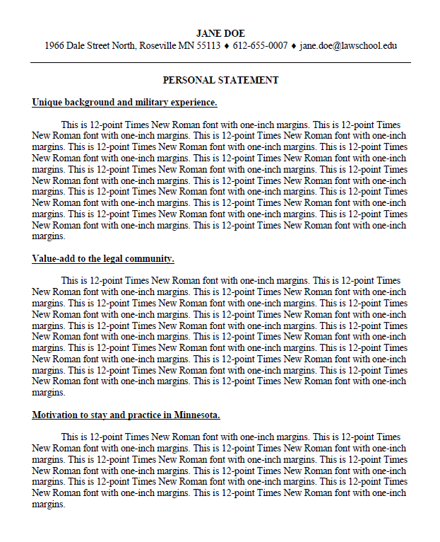
Exemplar Personal Statement (3 of 3)
3-part substantive question:
How your identity, background, culture, or life experience makes you unique;
How your unique perspective will add value to the legal community; and
What motivates you to stay and practice law in Minnesota.
Contact info/title
Point headings address each part of the question

Slide 16
Legal Writing Evaluation (1 of 2)
Requirements:
Demonstrate legal reasoning skills
8-12 pages
Grader will evaluate your:
Organization/structure
Clarity and composition
Citations
Grammar/spelling/formatting

Slide 17
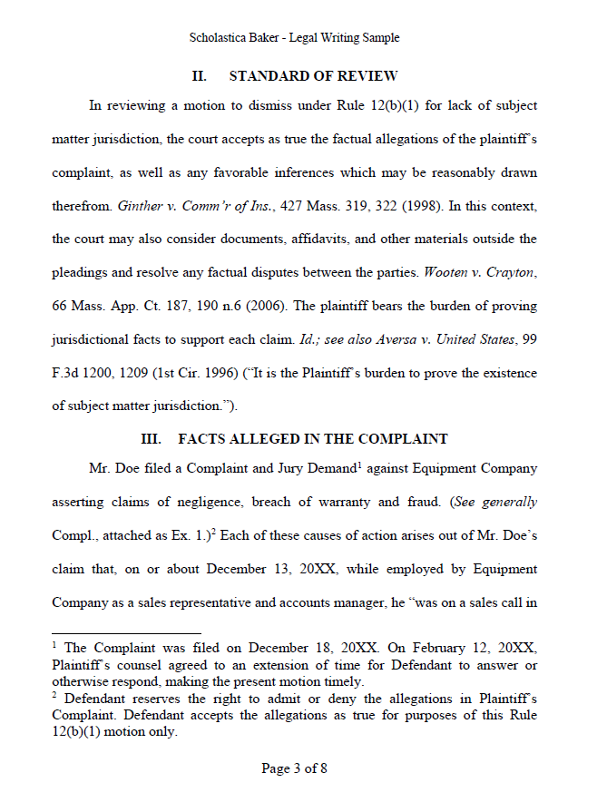
Exemplar Legal Writing Sample (2 of 2)
Demonstrate your legal reasoning skills
8-12 pages
Name
Subject “Legal Writing Sample”
Page numbers

Slide 18
Initial Interview Evaluation
Each category is graded 1-5:
Oral communication skills
Interpersonal skills
Motivation
Work experience, interests, and activities
Personal statement

Slide 19
Advice from 1L Law Clerks

Slide 21
Contact Information
HCBAClerkship@mnbars.org

